Slide 1
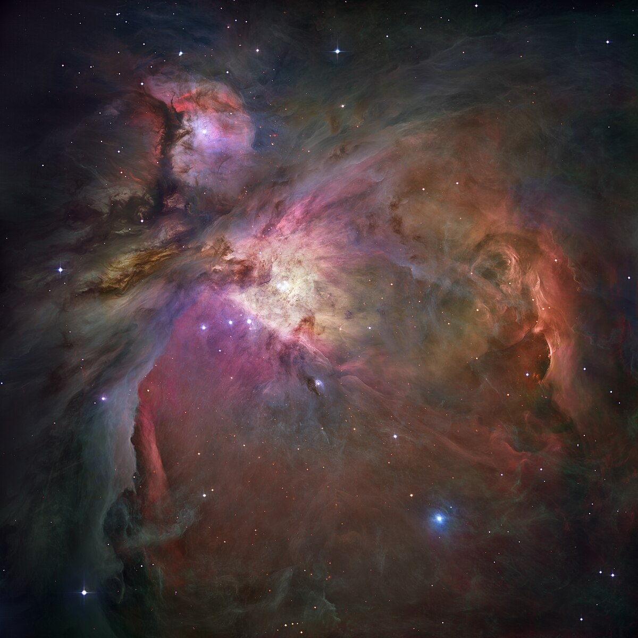

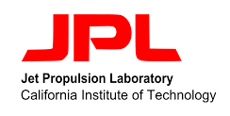



Spatial Heterodyne Interferometric Molecular Cloud Observer (SHIMCO)
Heerok Das, Hayden Marchinek, Jasmine Martinez Castillo
Mentored by Dr. Jason Corliss, Cole Meyer, Jo Flores, Naomi Yescas
Arizona Space Grant Symposium, April 19, 2025

Slide 2
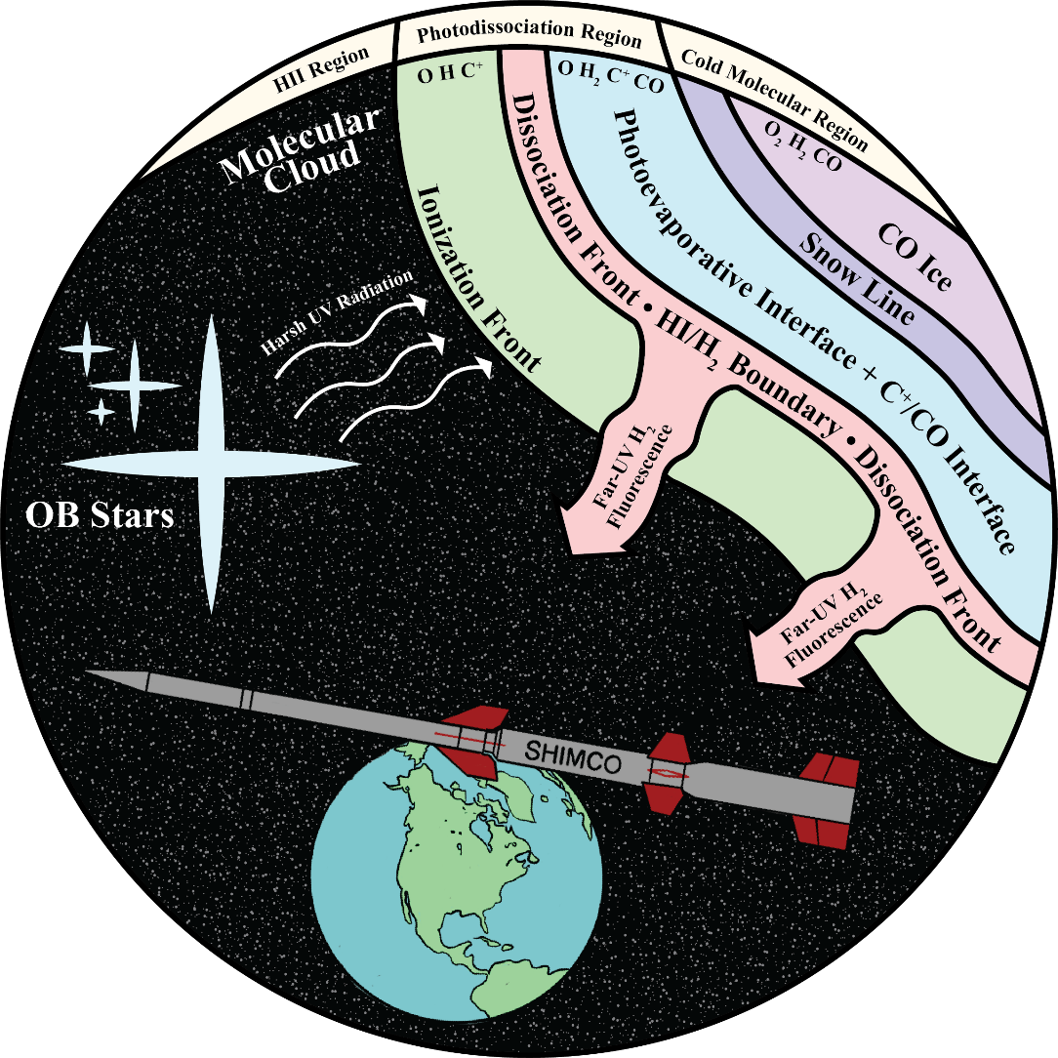
Scientific and Technical Objectives
Mission Goal: Observe dense H₂ regions around young O and B stars to understand molecular cloud evolution.
Challenges: Limited understanding of H₂ distribution due to observational challenges.
Pathfinder Potential: Validate H₂ mapping techniques and optimize SmallSat-class missions and instrumentation development.
Image Credit: Cole Meyer
2

Slide 3
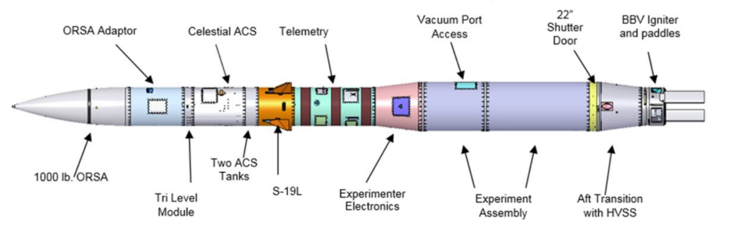
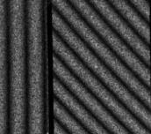
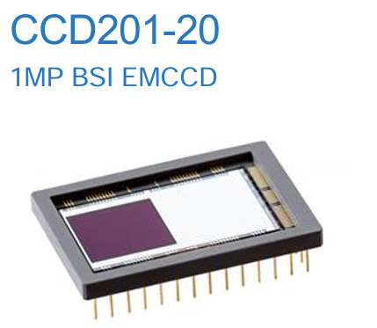
Mission Platform and Instrumentation
Black Brant XI Sounding Rocket
Effective for high altitude suborbital flight
Upgraded optical payload from (SHIELDS)
Reflective Spatial Heterodyne Spectrometer (RSHS)
Creates fringe patterns to be transformed into spectra
Custom EMCCD Detector
Currently being developed by JPL
δ-doped and AR coated for optimal UV observation
SHIMCO Equipment Proposal (Dr. Jason Corliss)
RSHS Interference
EMCCD
3

Slide 4
Presentation Overview
Target Selection
Electronics Devices and Command Operations
Novel Detector Operation Software
4

Slide 5

Target Selection
5

Slide 6
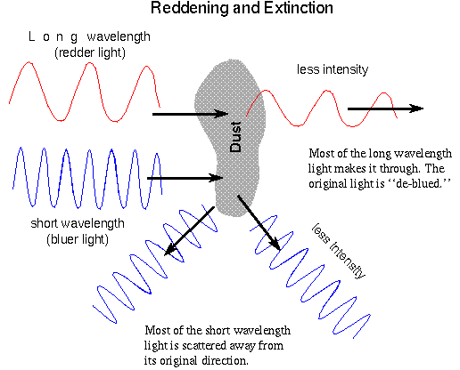
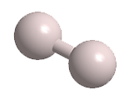
Background
H₂ is very difficult to observe
Low probability transitions
Emission/absorption lines are at UV wavelengths
Stars form in molecular clouds
The dominant component of molecular clouds is molecular hydrogen (H₂)
6
24

Slide 7
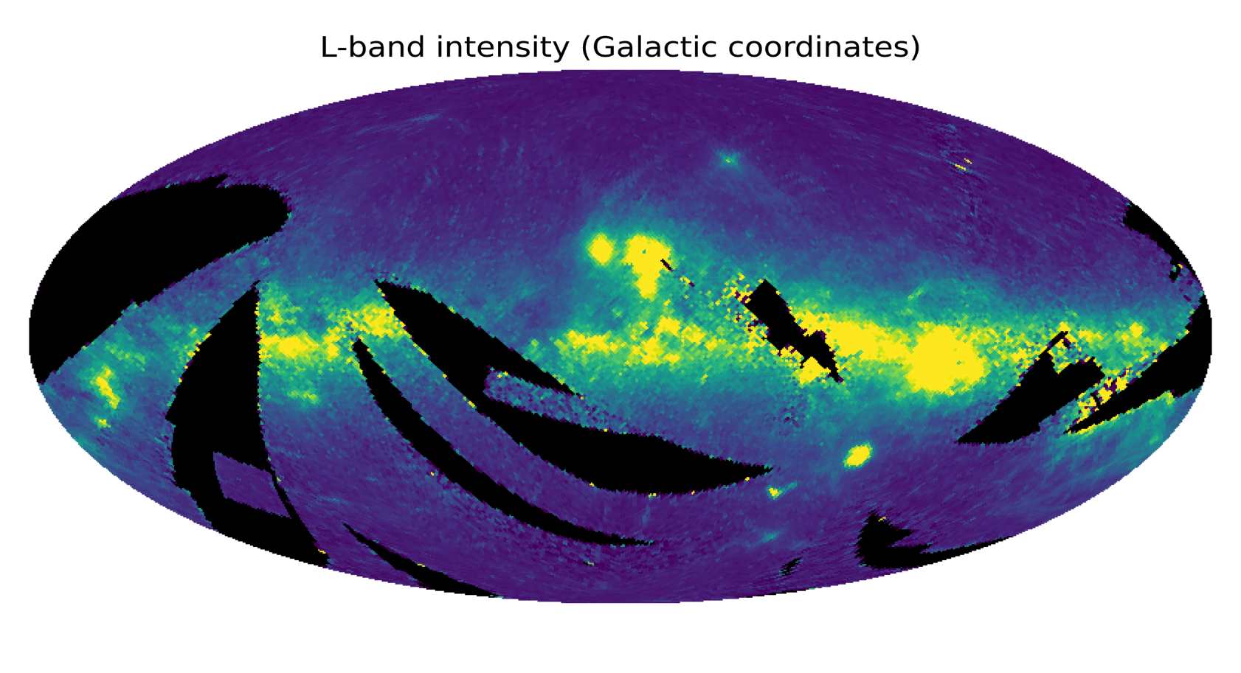
Our science goal
Obtain high-resolution far-ultraviolet (FUV) spectra of molecular hydrogen (H₂) fluorescence emission within molecular clouds, to probe the conditions of these complex star-formation regions
Considerations
Visibility from our launch site (~32°N)
Distance to the molecular cloud
Dust extinction
Shape of extinction profile
FIMS-SPEAR coverage
Proximity of O and B stars
All-sky FUV (1370-1710Å) intensity map from the FIMS-SPEAR mission
7

Slide 8
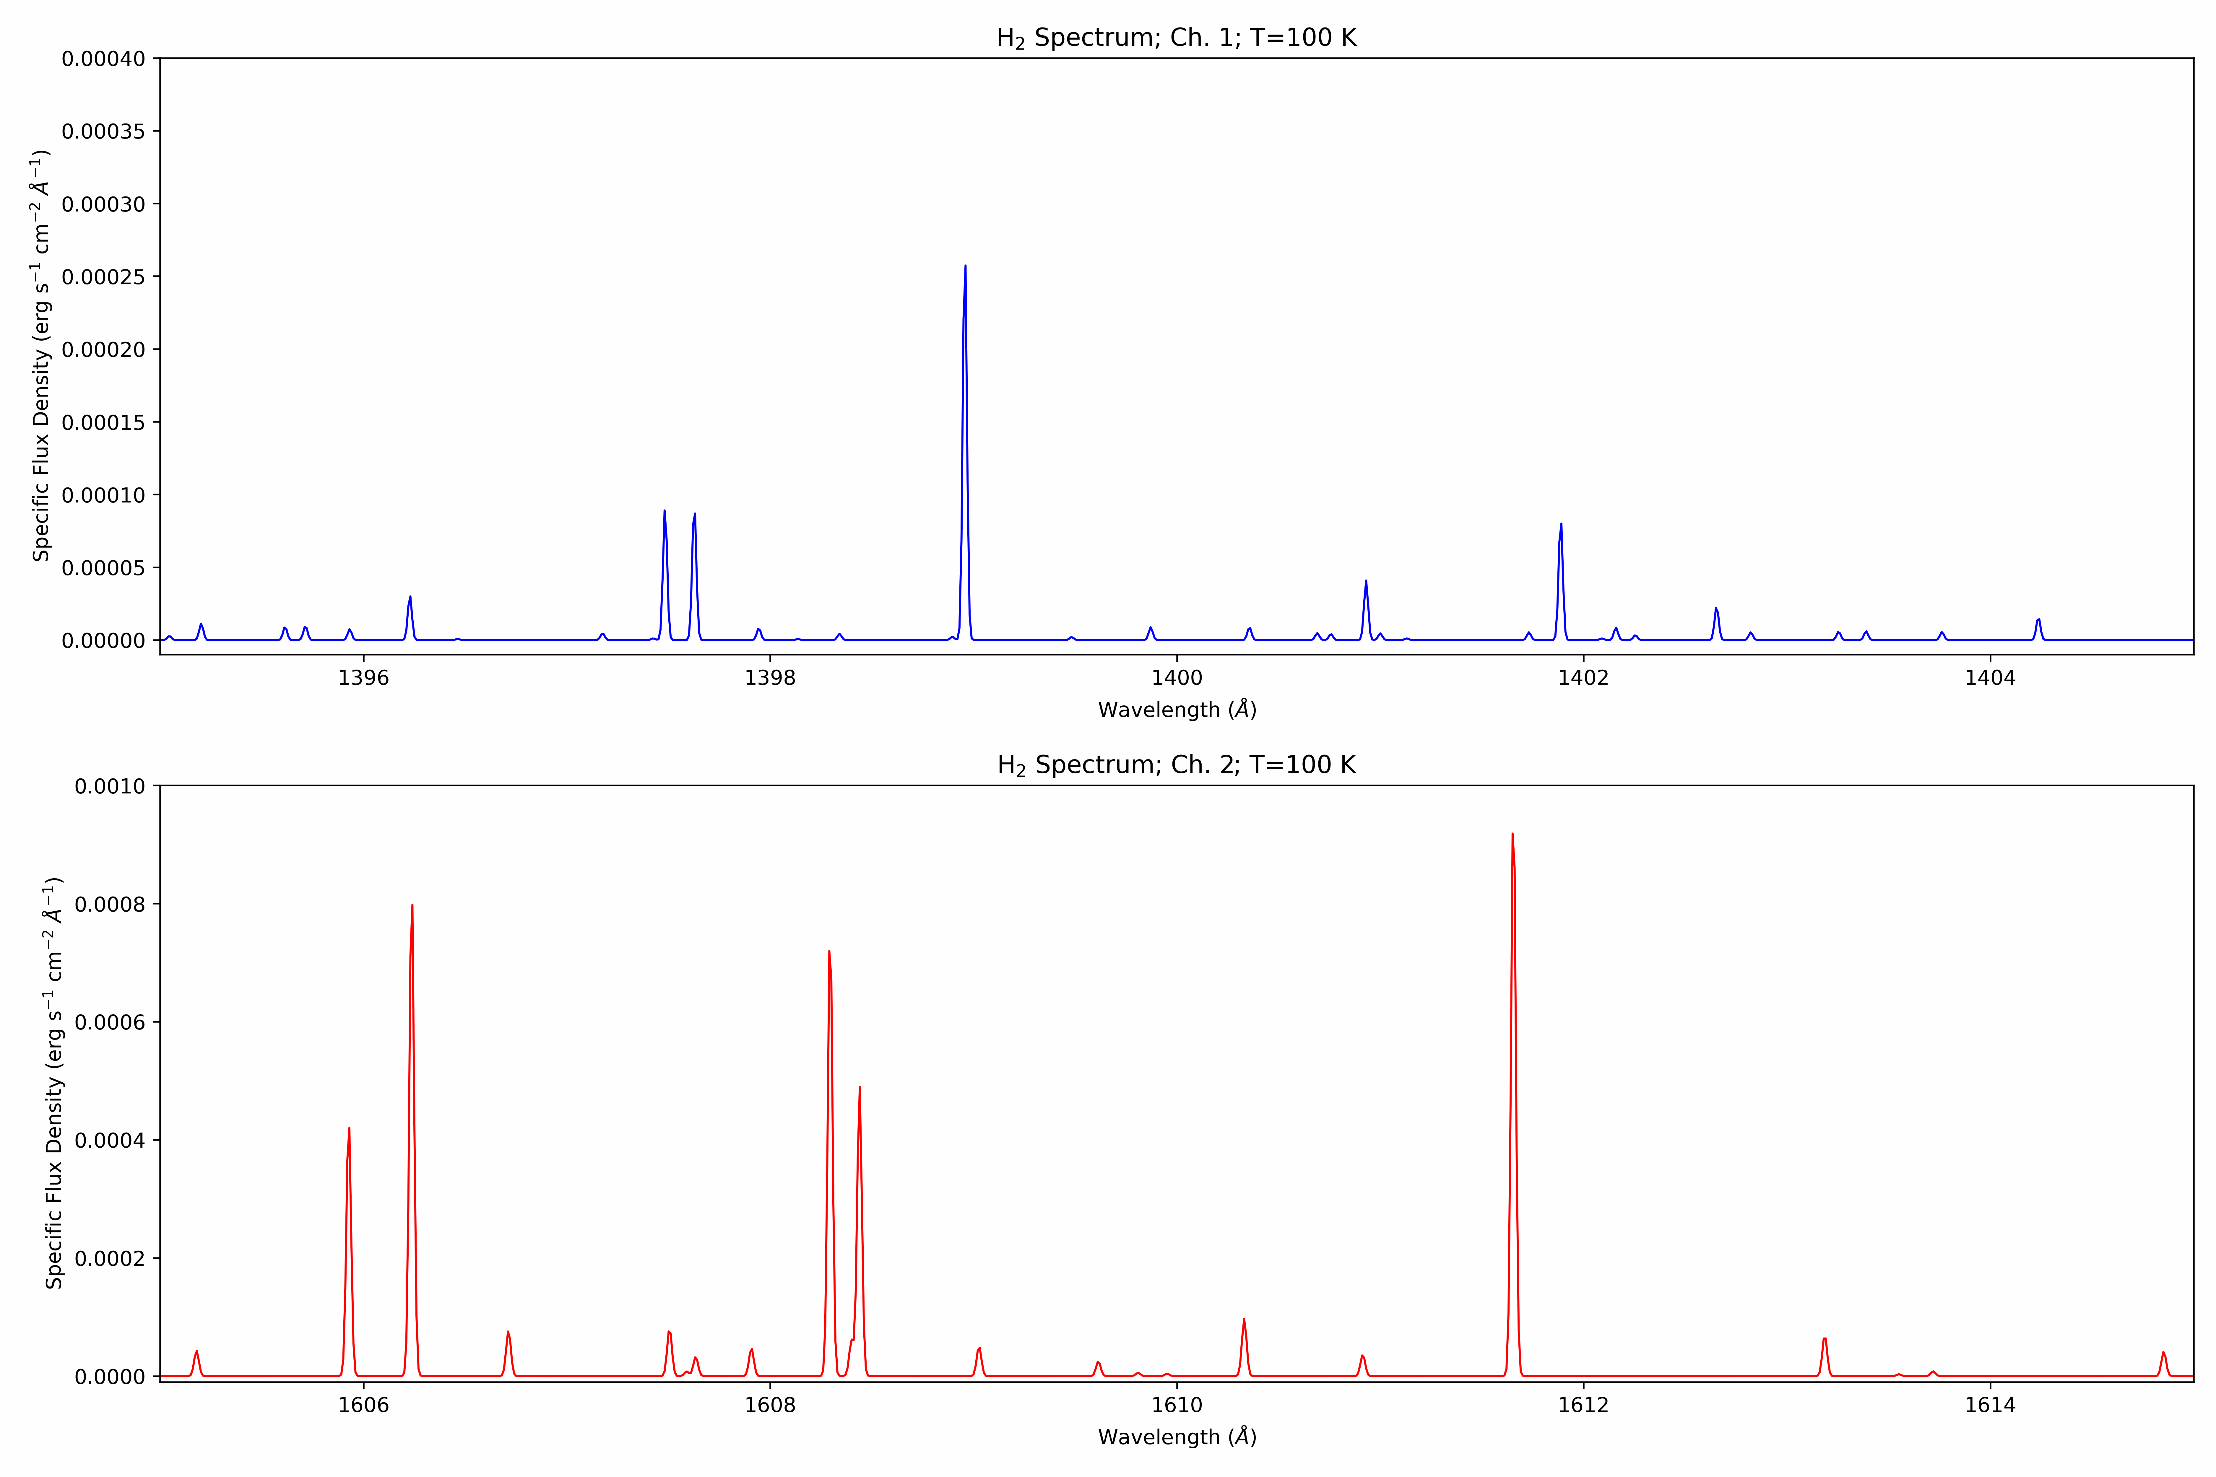
Theoretical SHIMCO Spectrum from H₂ Emission
8

Slide 9
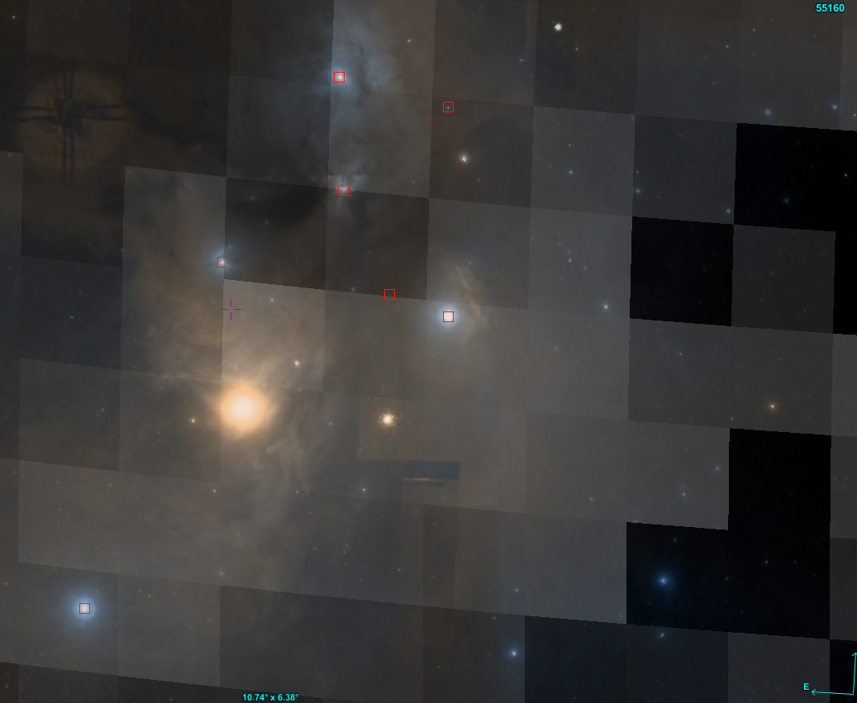
ρ Ophiuchi Complex
Background – Visible light imagery from the Digitized Sky Survey
Foreground – Average intensity over our bandpass, from FIMS-SPEAR dataset
22 Scorpii – B3
9

Slide 10
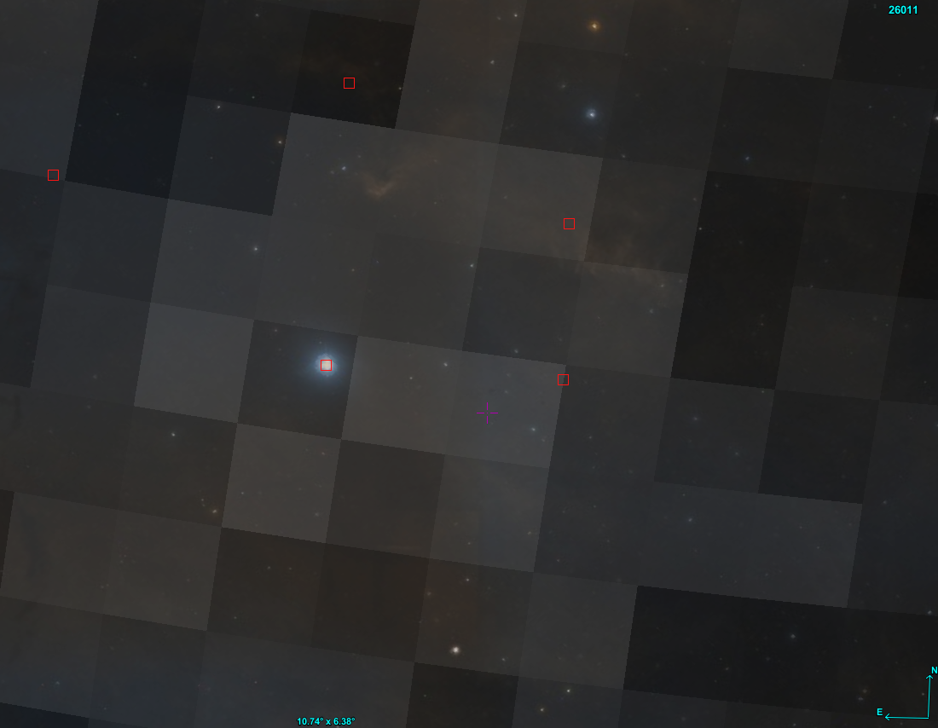
ζ Ophiuchi Region
Background – Visible light imagery from the Digitized Sky Survey
Foreground – Average intensity over our bandpass, from FIMS-SPEAR dataset
ζ Ophiuchi – O9.5
10

Slide 11
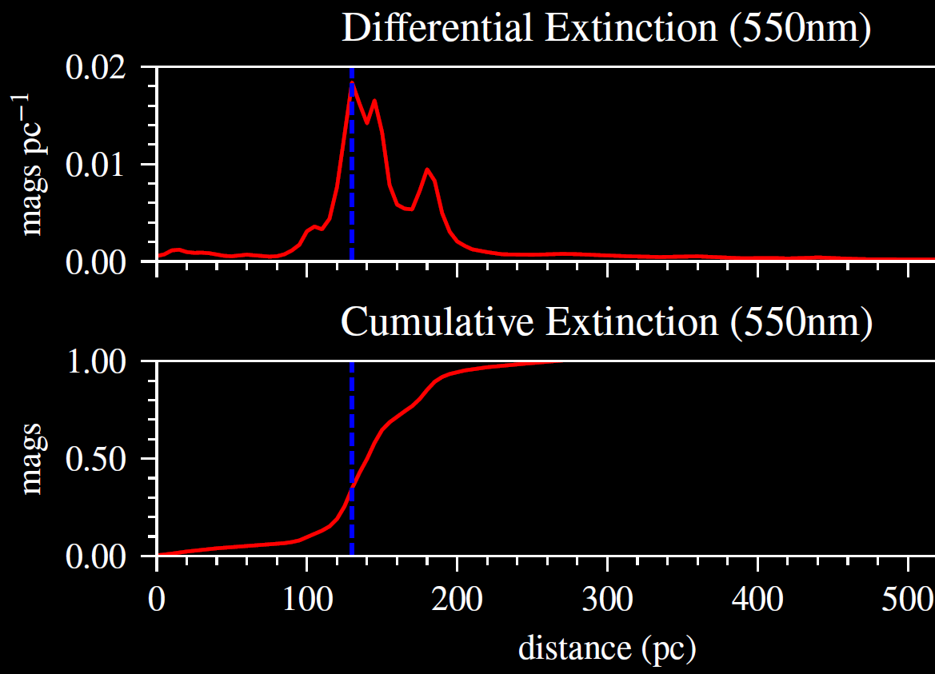
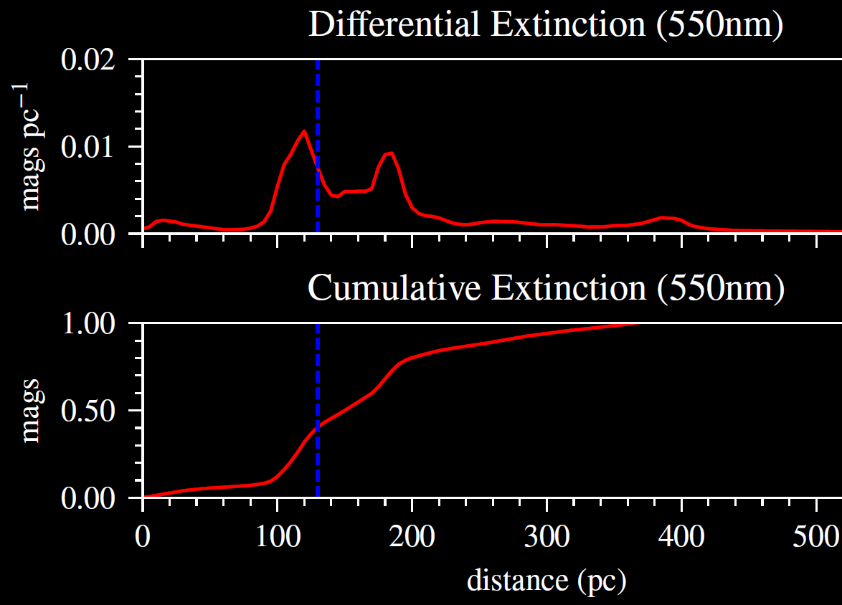
Dust Extinction
Towards 22 Scorpii
Towards ζ Ophiuchi
11

Slide 12
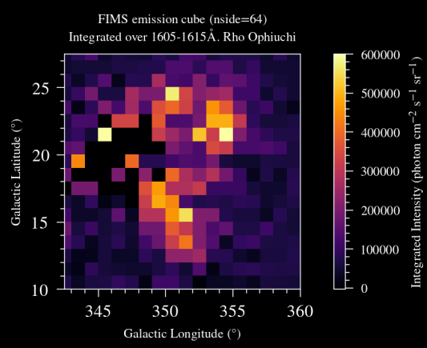
Next Steps for target selection
Identify specific targets within the larger complex
High-intensity emission across our bandpass
Aligns with mission goals
Suitable distance from a star
Velocity dispersion
More precise model of theoretical spectra
Specific Target
Analyzing effects of dust
S/N calculations
12

Slide 13
SHIMCO Command Operation and Electronics Devices
13

Slide 14
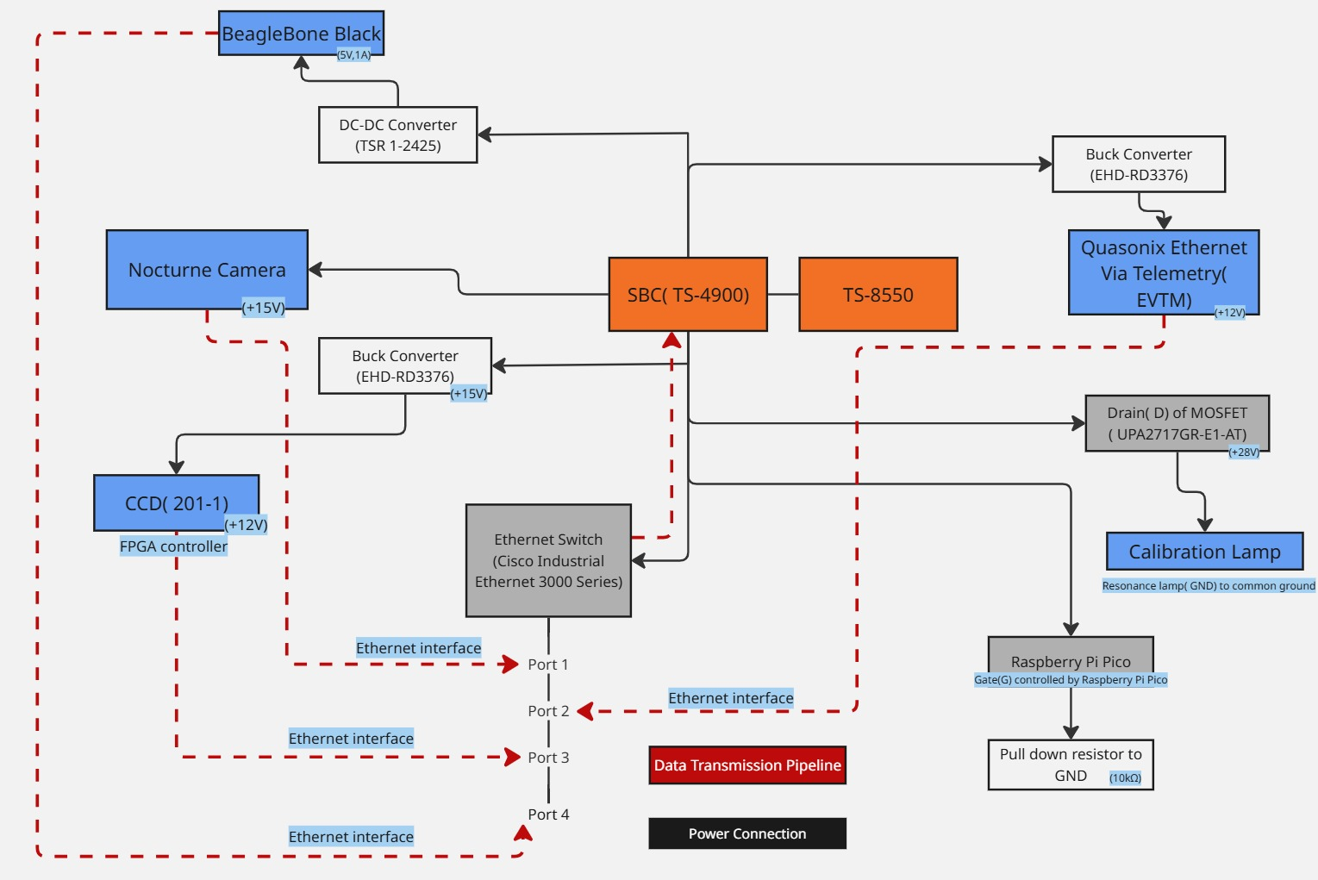
Electronics Decks Overview
Device cheat sheet
Single Board Computer(SBC)
Power Regulating Hardware
Data Regulating Hardware
Critical Experimental Devices
14

Slide 15

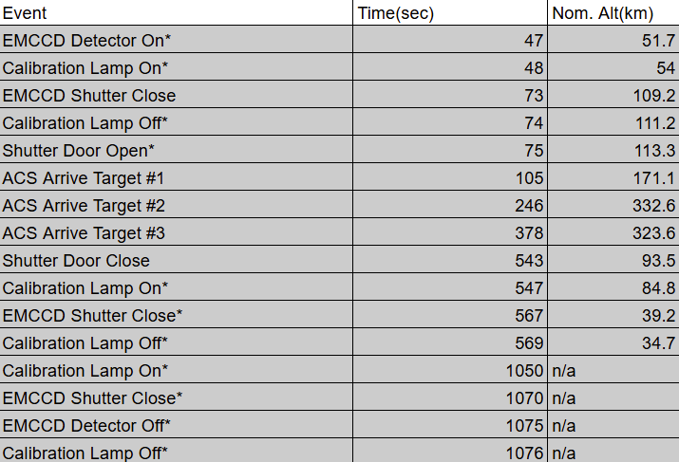
Flight Events and Command Operations
Uplink
Ground commands sent for operating flight-event based devices
Downlink
Onboard data streamed to ground station
Critical Experimental Devices
Devices that are dependent on flight conditions( altitude, temperture, etc.)
Housekeeping Data
Automated sensors streaming flight conditions
15

Slide 16
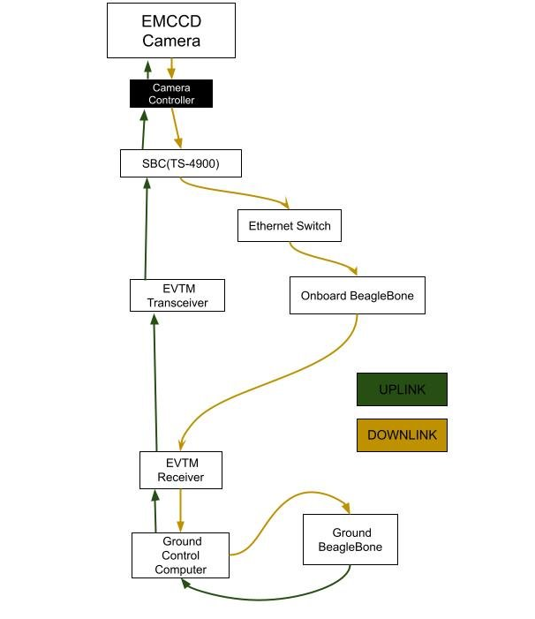
Integration of Artificial Intelligence Prototype
Image Analysis
Data Packet Verification
Failure Handling
16

Slide 17
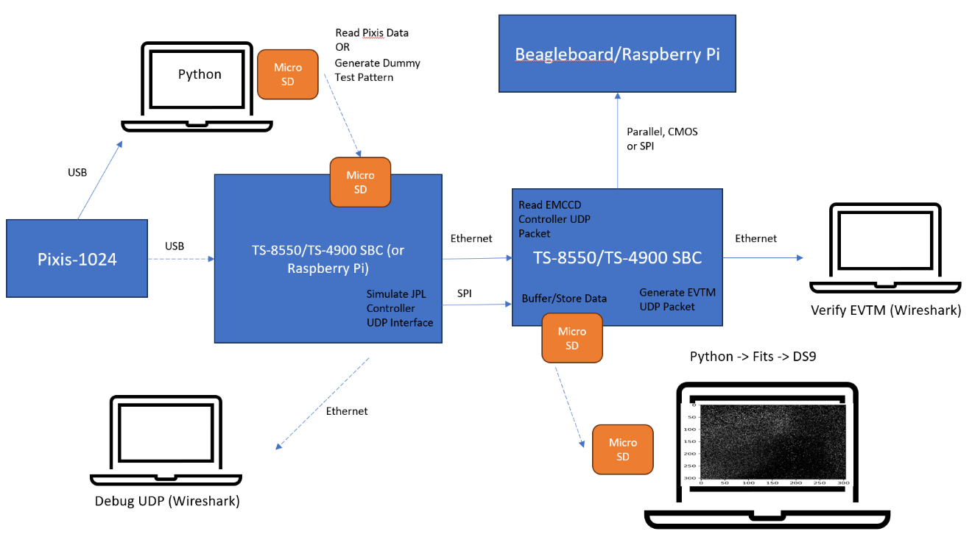
Next Steps in Data Transmission
Constructing a pseudo data transmission pipeline to simulate communication between the single board computer and the camera controller( TS-8550/TS-4900 SBC or Raspberry Pi).
(Data Transmission Pipeline Mock Setup_ Designed by Naomi Yescas and Jasmine Martinez)
17

Slide 18
Novel Detector Software
18

Slide 19


Software for EMCCD Interface: The Need
Parameter Adjustment
Image Capture
EMCCD
EMCCD
Attribute Monitoring
Image Data
Image Visualization
Image Analysis
Data Saving
19

Slide 20
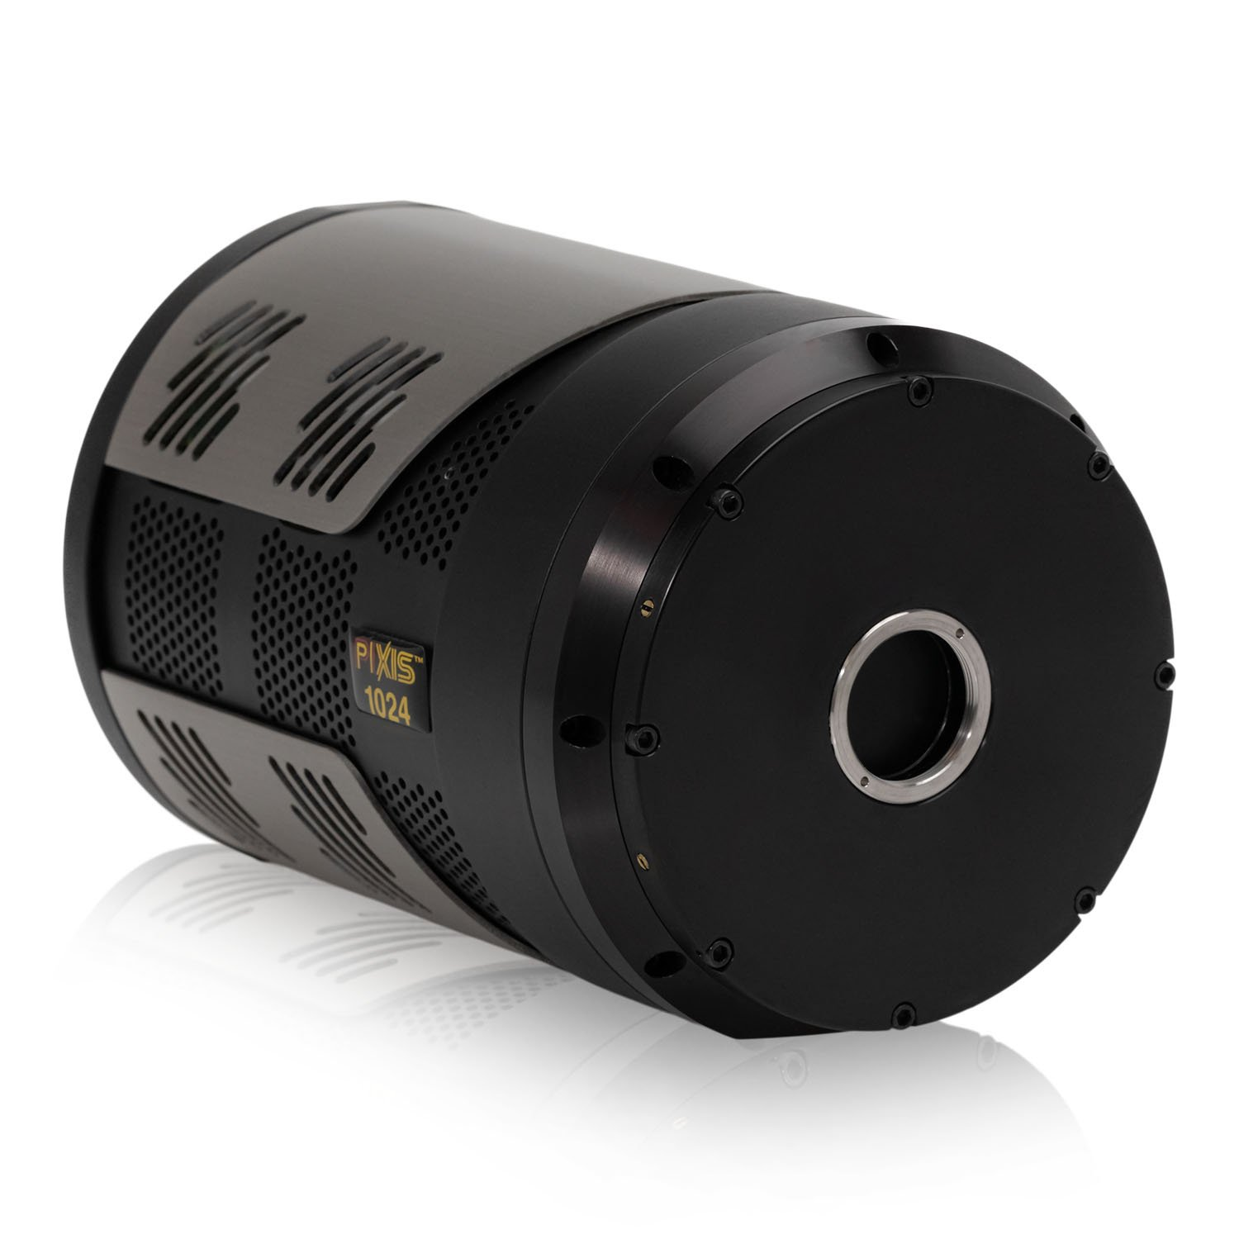

Software for EMCCD Interface: PIXIS 1024
Placeholder for EMCCD
Princeton Instruments CCD
Designed for high sensitivity imagery
200 $µ$m – 1100 $µ$m Spectral Range
Conforms to PICAM API
20

Slide 21
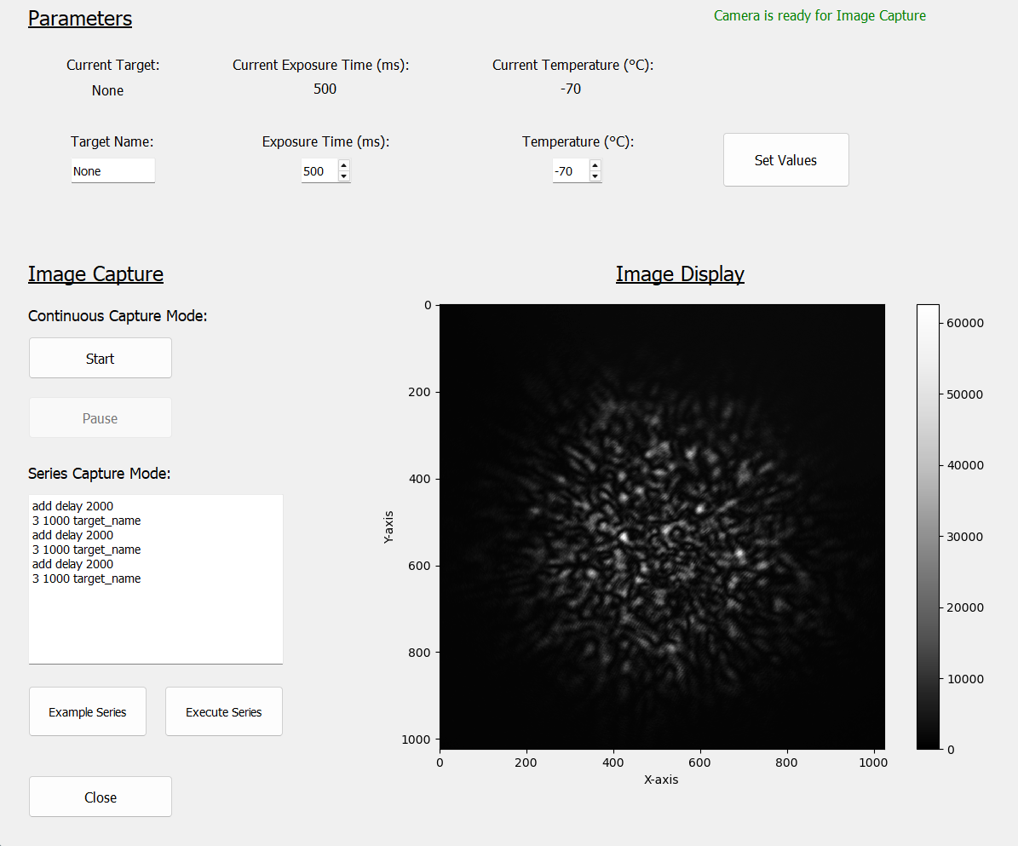
21

Slide 22
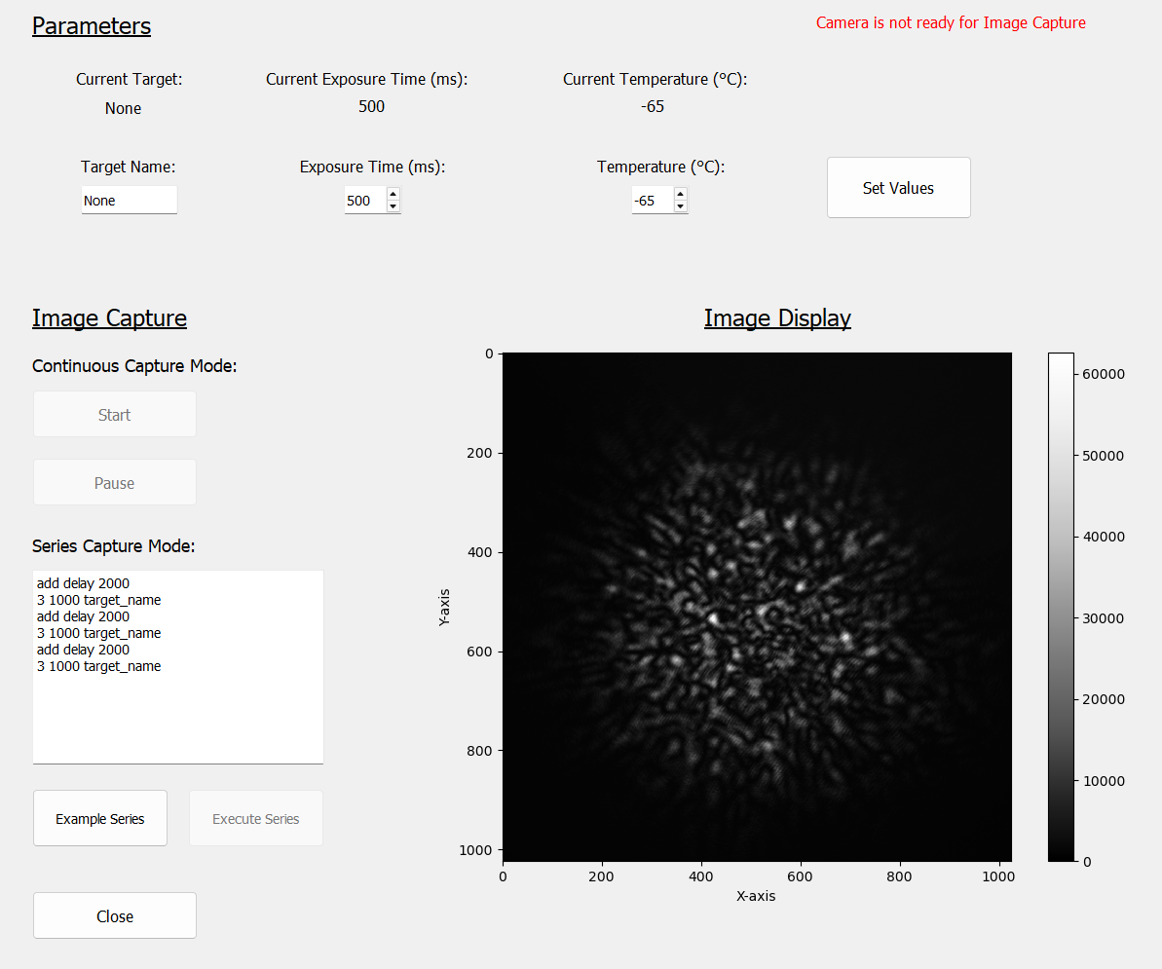
22

Slide 23
Integrating the EMCCD: Next Steps
Update Wrapper for EMCCD
Implementation into Data Pipeline
Data acquisition and Visualization
Mission ready diagnostics
23

Slide 24
Acknowledgements:
Dr. Jason Corliss
Dr. Walter Harris
Cole Meyer
Naomi Yescas
Jo Flores
Javier Alday
Elijah Garcia
Daniel Truong
24

Slide 25
Thank You

